Slide 1
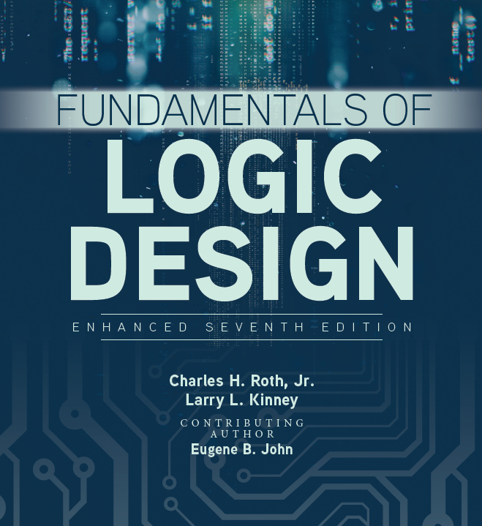

Unit 1
Introduction Number Systems and Conversion

Slide 2
Quick review for last class
Digital system: physical quantities can only be discrete value.
Digital signal vs. Analog signal
Switching circuit: combinational circuit vs. sequential circuit

Slide 3
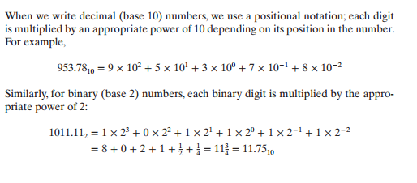
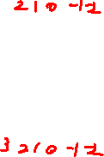
Number Systems and Conversion
Explanation of decimal and binary numbers:
When we write decimal (base 10) numbers, we use a positional notation; each digit is multiplied by an appropriate power of 10 depending on its position in the number.
When we write binary (base 2) numbers, each digit is multiplied by an appropriate power of 2 on its position in the number.

Slide 4
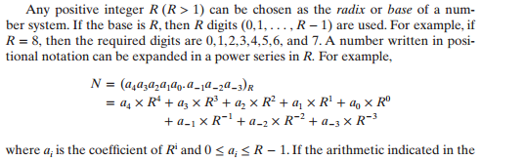
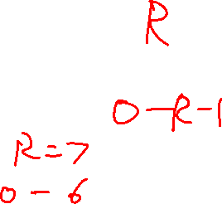
Number Systems and Conversion
Power series expansion in any number system of base R:

Slide 5
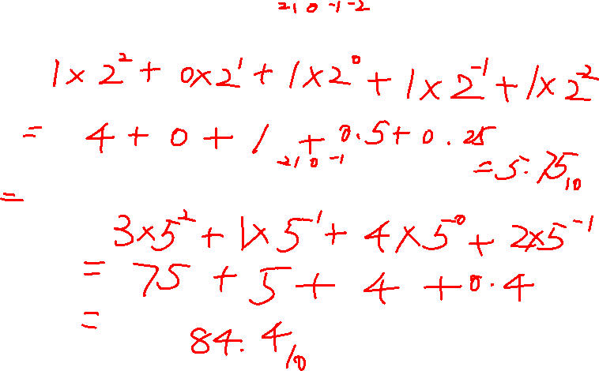
Examples
Base-2 to Base-10 conversion: 101.112 =
Base-5 to Base-10 conversion: 314.25 =

Slide 6
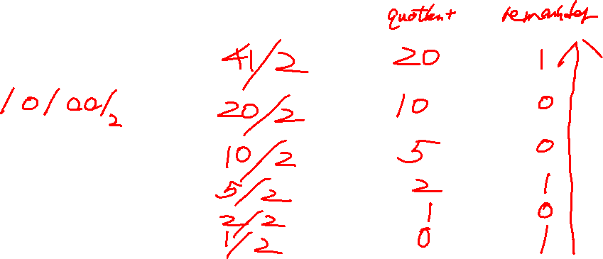

Base-10 integer to Base-2
Divide integer by 2 iteratively and get the quotients and remainders.
Read reminders in reverse order
Example: 4110=

Slide 7
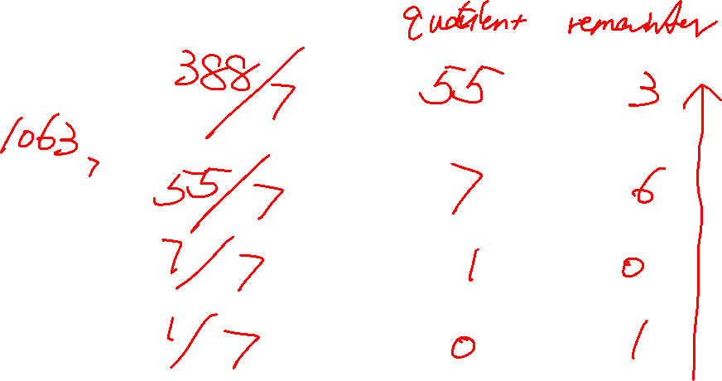
From Base-10 integers to Base-7
38810=

Slide 8
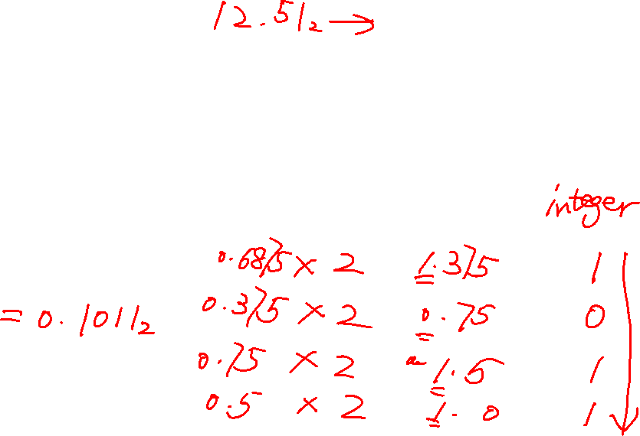

From Base-10 fractions to Base-2
Multiply fractions by 2 iteratively and get the integer product and fraction.
Read integer in order
Example: 0.687510=

Slide 9

From Base-10 fractions to Base-2
The fractional part begins repeating every 4 steps, yielding repeating 1001 forever
round/truncate
0.6510=0.10100110011001…

Slide 10
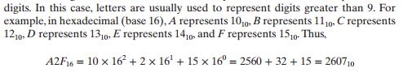

Number Systems and Conversion
Bases greater than 10:
For bases greater than 10, more than 10 symbols are needed to represent the digits.

Slide 11

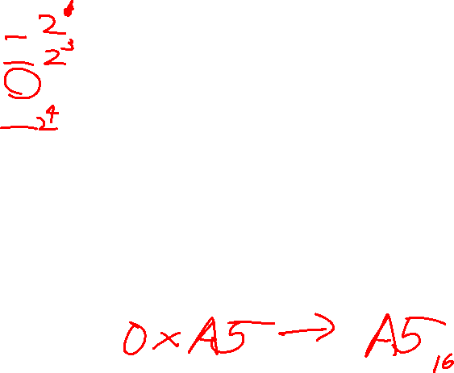
Name | Radix | Digits
Binary | 2 | 0, 1
Octal | 8 | 0, 1, 2, 3, 4, 5, 6, 7
Decimal | 10 | 0, 1, 2, 3, 4, 5, 6, 7, 8, 9
Hexadecimal | 16 | 0, 1, 2, 3, 4, 5, 6, 7, 8, 9, A, B, C,
 |  | D, E, F
The six letters A, B, C, D, E, and F in hexadecimal represent the digits for values 10, 11, 12, 13, 14, 15 respectively
Usually, the prefix 0x is added to indicate a hexadecimal number – e.g. 0xA5

Slide 12
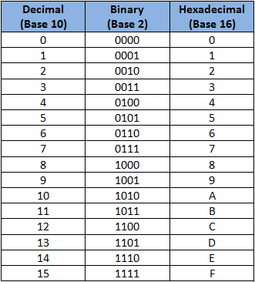


Slide 13
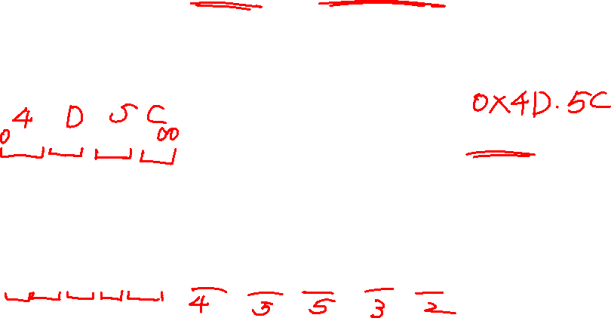
Number Systems and Conversion
Conversion from binary to hexadecimal and binary to octal:
Conversion from binary to hexadecimal (and conversely) can be done by inspection because each hexadecimal digit corresponds to exactly four binary digits (bits).
A similar conversion can be done from binary to octal, base 8 (and conversely), except each octal digit corresponds to three binary digits, instead of four.
100101101011010₂= 100 101 101 011 010 = 45532₈

Slide 14
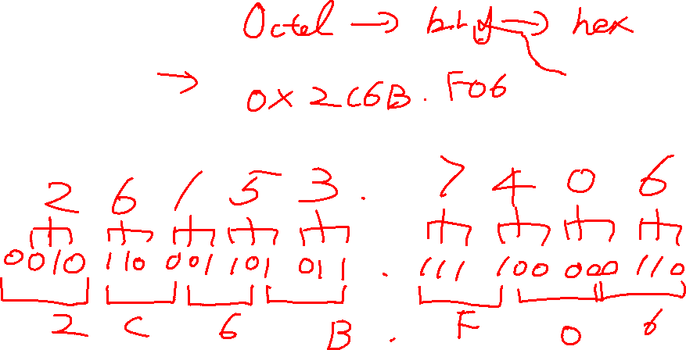
Octal to Hexadecimal
26153.7406₈
What is the process?

Slide 15
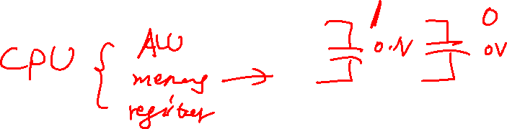
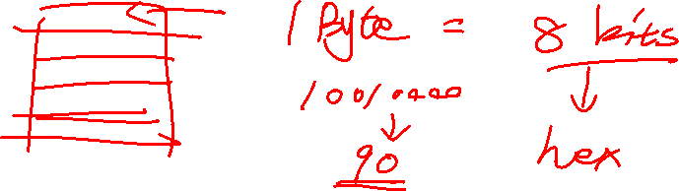
Questions
Why don’t we use decimal in computer?
Why do we prefer hexadecimal to decimal in computer system?

Slide 16
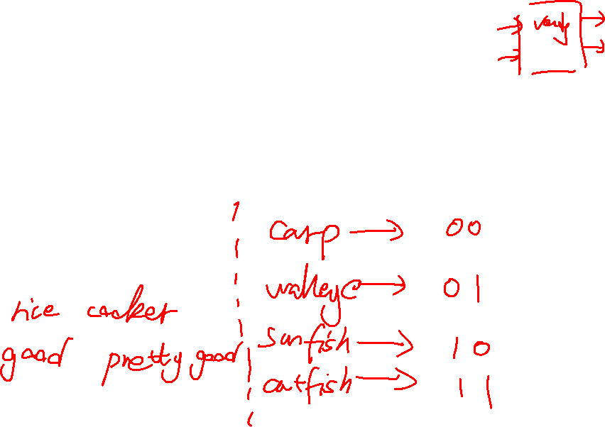
Binary coding
Flexibility of representation
can assign any binary combination (called a code word) to any data as long as data is uniquely encoded
Information Types
Numeric
Non-numeric

Slide 17
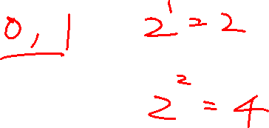
Non-numeric binary code
Given n bits, a binary code is a mapping from a set of represented elements to a subset of the 2^{n} binary numbers

Slide 18
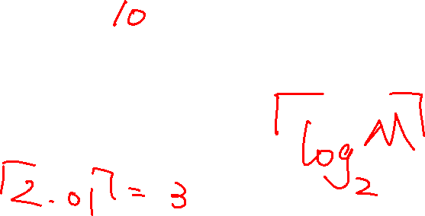
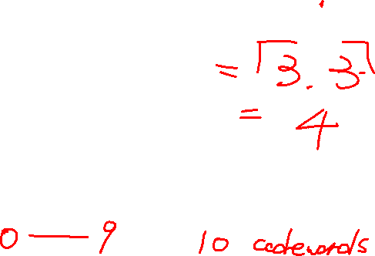
How many bits are required to represent decimal digits with a binary code?
Given M elements, n minimum number of bits are needed to generate the codewords for all the elements.

Slide 19
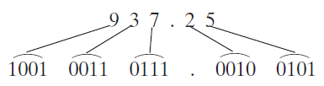
Binary Codes
Although most large computers work internally with binary numbers, the input-output equipment generally uses decimal numbers.
Because most logic circuits only accept two-valued signals, the decimal numbers must be coded in terms of binary signals.
In the simplest form of binary code, each decimal digit is replaced by its binary equivalent. For example, 937.25 is represented by:

Slide 20
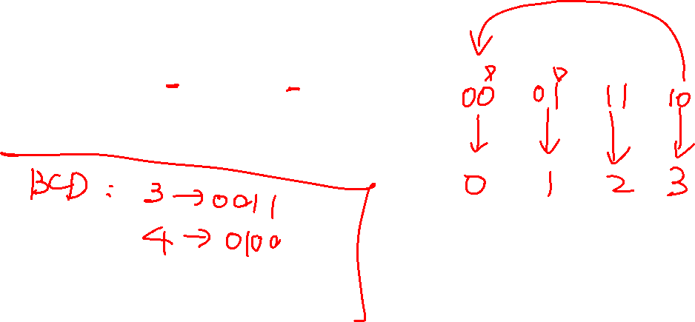
Gray code
Gray code is a binary code where two successive values differ in only one bit change
3₁₀ to 4₁₀:
0111_{GC} → 0110_{GC}

Slide 21

Decimal codes – BCD and gray code
Two useful ways to code decimal digits into binary are Binary Coded Decimal (BCD) and Gray Code
Decimal | BCD | Gray Code
0 | 0000 | 0000
1 | 0001 | 0100
2 | 0010 | 0101
3 | 0011 | 0111
4 | 0100 | 0110
5 | 0101 | 0010
6 | 0110 | 0011
7 | 0111 | 0001
8 | 1000 | 1001
9 | 1001 | 1101

Slide 22
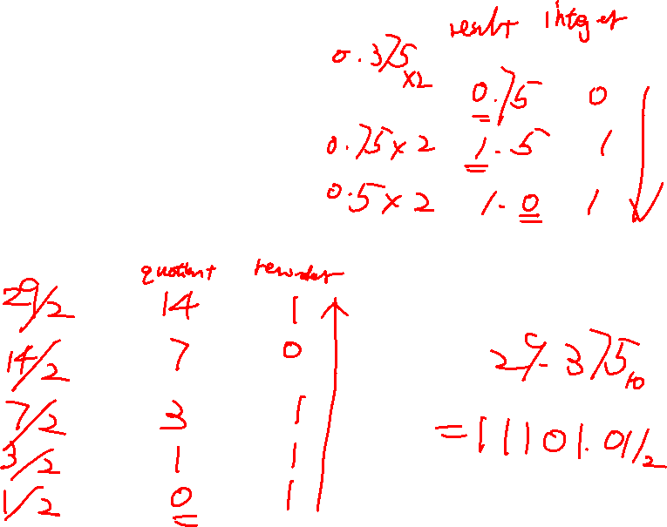
Practice
Covert 29.375 from decimal to binary

